Slide 1
The Secrets to Video Game Success
Factors that Affect Ratings and Sales

Slide 2

TABLE OF CONTENTS
Introduction
01
Questions
02
Methods, Analysis, Charts
03
Conclusion and Limitations
04
Team and Objective
Areas of Investigation
Data Cleaning and Plotting
Conclusion and Limitations

Slide 3



OUR TEAM
MELANIE FOLLETT
Team Lead
WILLIAM VO
Productive Team Member
JONATHAN WU
Productive Team Member

Slide 4

OBJECTIVE
Our project will investigate what factors affect whether a video game is successful or not based on video game ratings and sales.

Slide 5

TIMELINE
01/16
01/18
Further Cleaning.
Created Charts.
Continuation of creating visualizations.
01/11
01/14
01/21
Final Day
Exploring our inquiries
Data Cleaning. Created Master Clean Data.
Gather up all charts. Generate Report.
Review report and generate presentation.

Slide 6

Global Sales vs. Critic Ratings
QUESTIONS
Is there a relationship between video game global sales and critic ratings score? Do games that have higher ratings tend to sell better?

Slide 7
Global Sales vs. Critic Ratings for Different Genres
Global Sales for Different Genres Across Years
How do global sales and critic ratings vary across video game genres? Which genres sell the best and which are rated the highest?
How do global sales for different video game genres vary across the years? Does the popularity of different genres vary over time?

Slide 8
Global Sales vs. Critic Ratings for Different Platforms
Global Sales for Video Game Genres for Different Platforms
How do video games sales vary between genres for each platform? Does the most popular genre for each platform vary?
How do global sales and critic ratings vary across video game platforms? Which platforms have games that sell the best and which are rated the highest?

Slide 9
Sales per Region for Different Genres
Sales per Region for Different Platforms
How do video game sales vary between regions (NA, PAL, JP, Rest of the World) for different genres? Do different genres sell better in certain regions?
How do video game sales vary between regions (NA, PAL, JP, Rest of the world) for different platforms? Do different platforms sell better in certain regions?

Slide 10
Global Sales vs. Critic Ratings for Different Publishers
How do global sales and critic ratings vary for different publishers? Which publishers have games that sell the best and which are rated the highest?
Number of Games Sold by Different Publishers
Which publishers released the most games? Did publishers that released the most games also have the highest global sales?

Slide 11
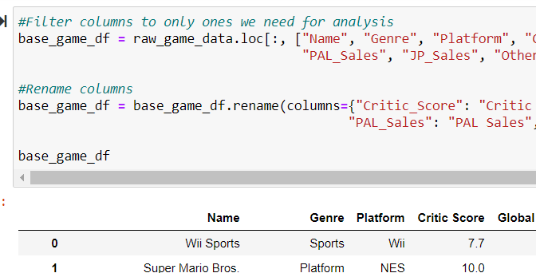
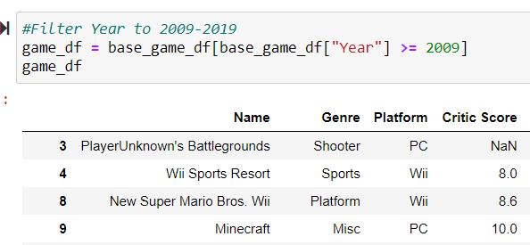
Cleaning the Master Data
Filter Columns
We filtered the columns based on what we collectively needed.
Rename Columns
Renamed the columns to improve readability.
Filter Years
Since we only wanted to utilize the most current and relevant data, we limited based on year.

Slide 12
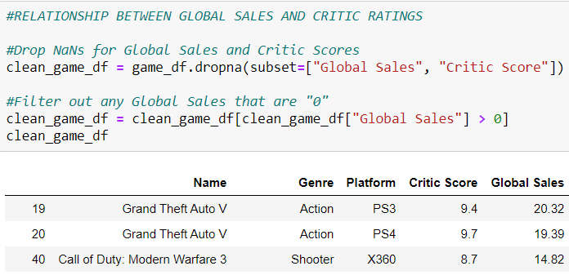
Relationship Between Global Sales and Critic Ratings
Removed Empty Cells
To further clean the data, we used a dropna function to clear out all NaNs.
Removed Zero Values
We removed any rows that had a zero value for Global Sales.

Slide 13
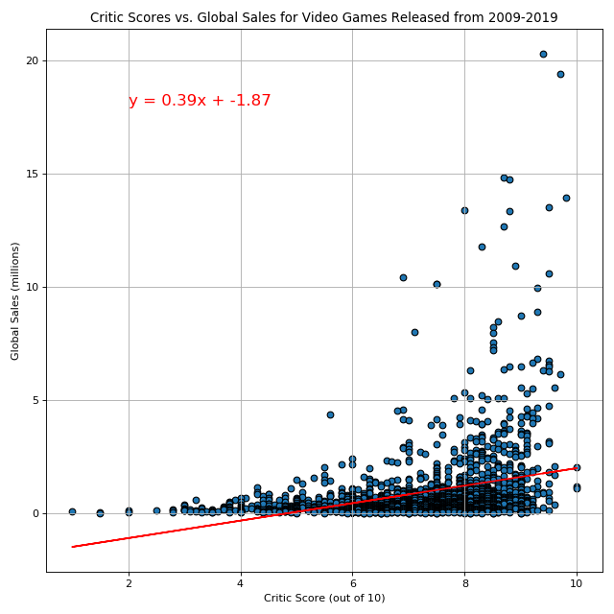
Relationship Between Global Sales and Critic Ratings
Positive
Both variables increase
Weak
R-squared = 0.32

Slide 14
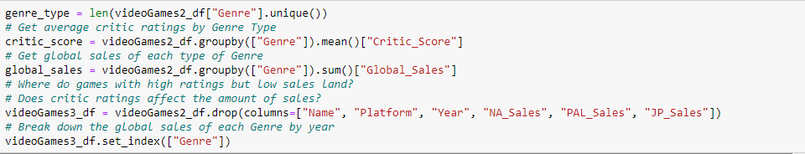
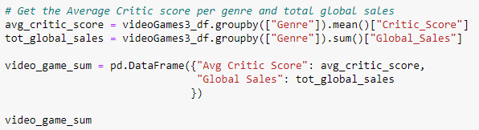
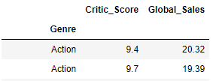
Global Sales vs. Critic Ratings for Different Genres
Group all the same genres together
We sorted the data and put all the game genre’s together.
3 Remove columns we aren’t using
We used the df.drop(columns=[]) function to remove data we weren’t using to answer this question
Get the Average Critic Score and Total Global Sales
We used the groupby.mean function to get the average critics score and groupby.sum to get the total global sales for each unique genre. From here we placed the data into a new dataframe.

Slide 15
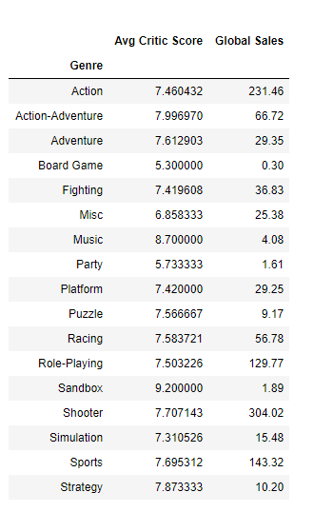
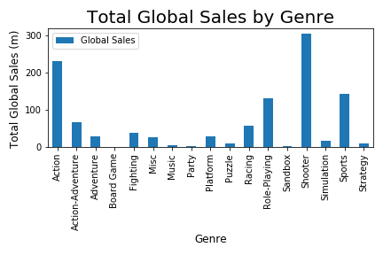
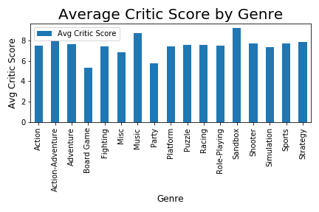
Global Sales vs. Critic Ratings for Different Genres
From the Data frame we plotted the data into 2 separate bar graphs. One showing the total global sales for each genre. The second graph to show the average critc score for each genre.
This is the result of the data frame. We have the average critic score for every game genre and the number of sales each genre has made globally.

Slide 16
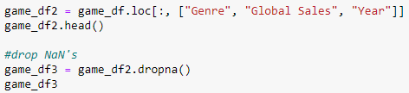
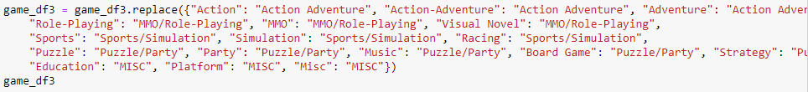
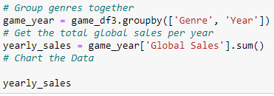
When looking at the yearly trend of video game sales by genre, we decided to only look from 2013-2017. We made the determination that there was not enough information for sales in 2018 that would present accurate data.
1. First, we filtered the years we wanted to look at and narrowed it down between 2013-2017 games only. 2. Then we dropped any rows with NaN values. 3. Finally, we decided to group genres together under one common category.
4. We used the groupby function to combine all the genres into one, but showed separate data from the years 2013-2017. 5. Finally we added all the global sales together within each category to see the total sales per year for each genre.
Global Sales for Different Genres Across Years

Slide 17
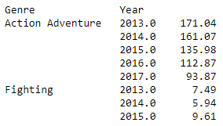
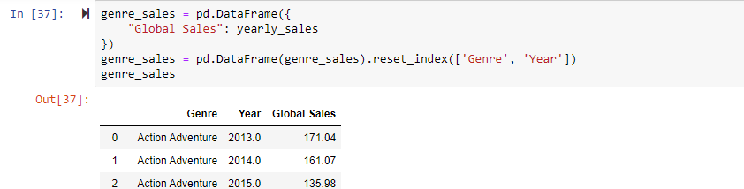
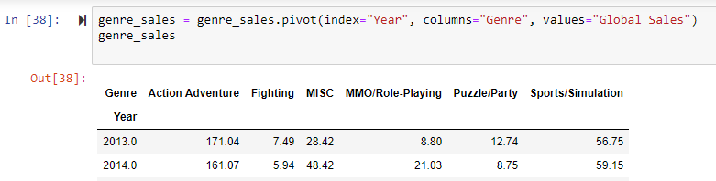
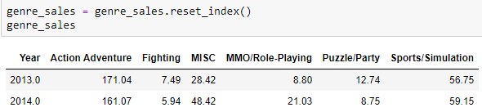
Global Sales for Different Genres Across Years
Convert to DataFrame
From the result, we had to convert the data into a data frame before creating the charts
Pivot & Reset Index
In order to create our multi line chart, we needed to put the genres into the columns and years into rows, so we used the pivot method to rearrange our values. Then we reset the index to the year.

Slide 18
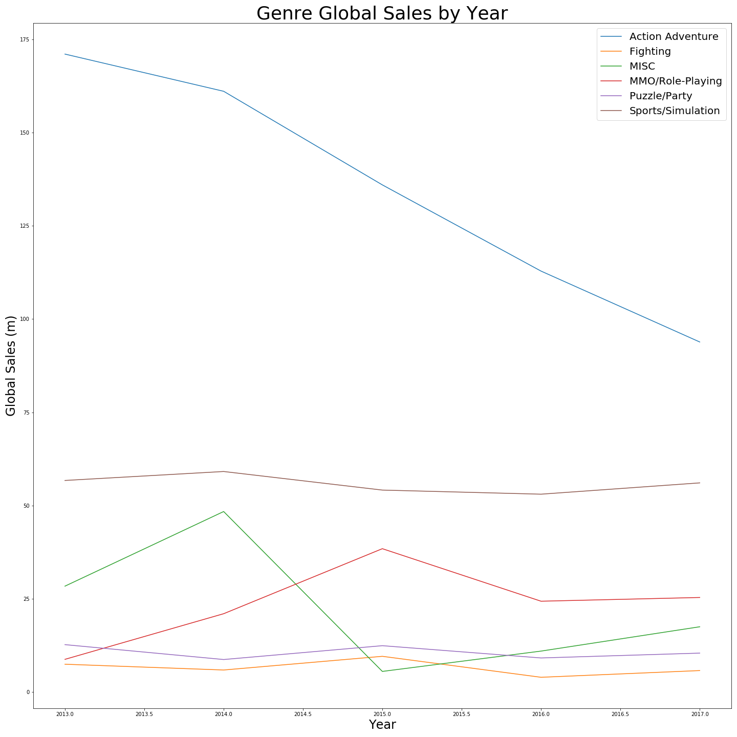
As we can see. Although “Action Adventure” type games have the most over all global sales, from 2013-2017 they have had the largest drops compared to every other category.
“Sports/Simulation”, “Fighting”, & “Puzzle/Party” games are the most consistent genres in sales.
“MMO/Role-Playing” Games had a nice increase in sales up to 2015, but started to drop in 2016 but maintained moving forward.
Although MISC games had a big drop between 2014-2015, we can see that those sales have been gradually increasing. We’d like to note that MISC games consist of mobile and indie type games. We expect that the sales will continue to increase seeing how our mobile phones are continually getting more advanced and powerful.
However, if a new game were to be developed, we believe that looking at a specific region would help decide what type of game should be made. Games do not have to necessarily be released globally and have global sales to be successful.

Slide 19
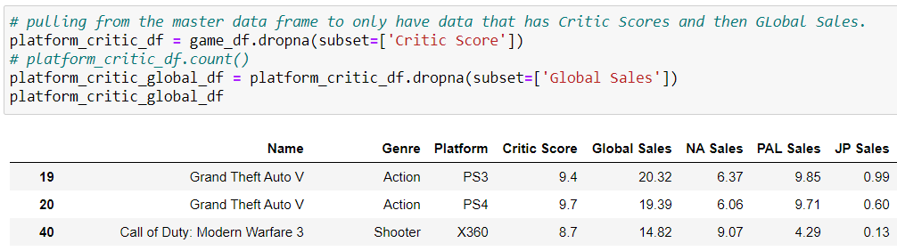
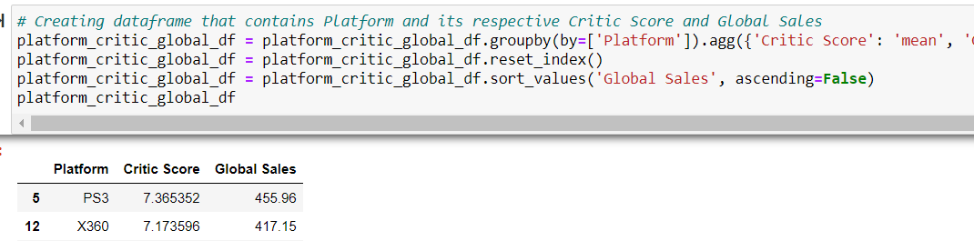
Global Sales vs. Critic Ratings for Different Platforms
Use .dropna Function
Limit the data based on rows that have Critic Scores.
Further limit based on Global Sales.
Use .groupby
Grouped by Platform, and then sorted by Global Sales.
Notes:
Dropping Unnecessary Data
I had to clean from the master data based on Critic Scores, as information without that data point would not be utilized. I then further cleaned NaNs based on Global Sales.
Group by Platform
I then grouped by platform with the mean critic score and summation of their Global Sales. Then I sorted the data in the dataframe.

Slide 20
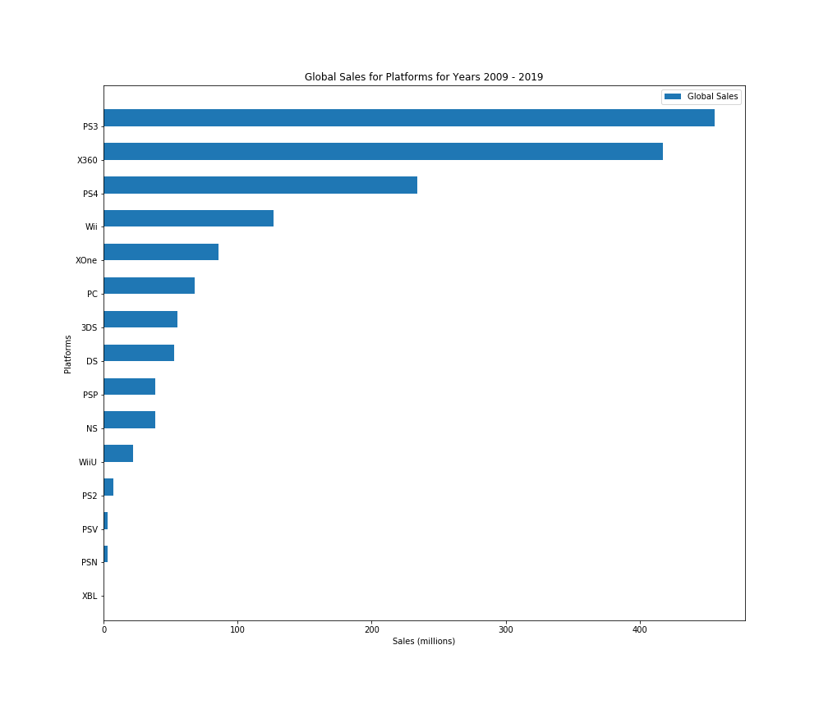
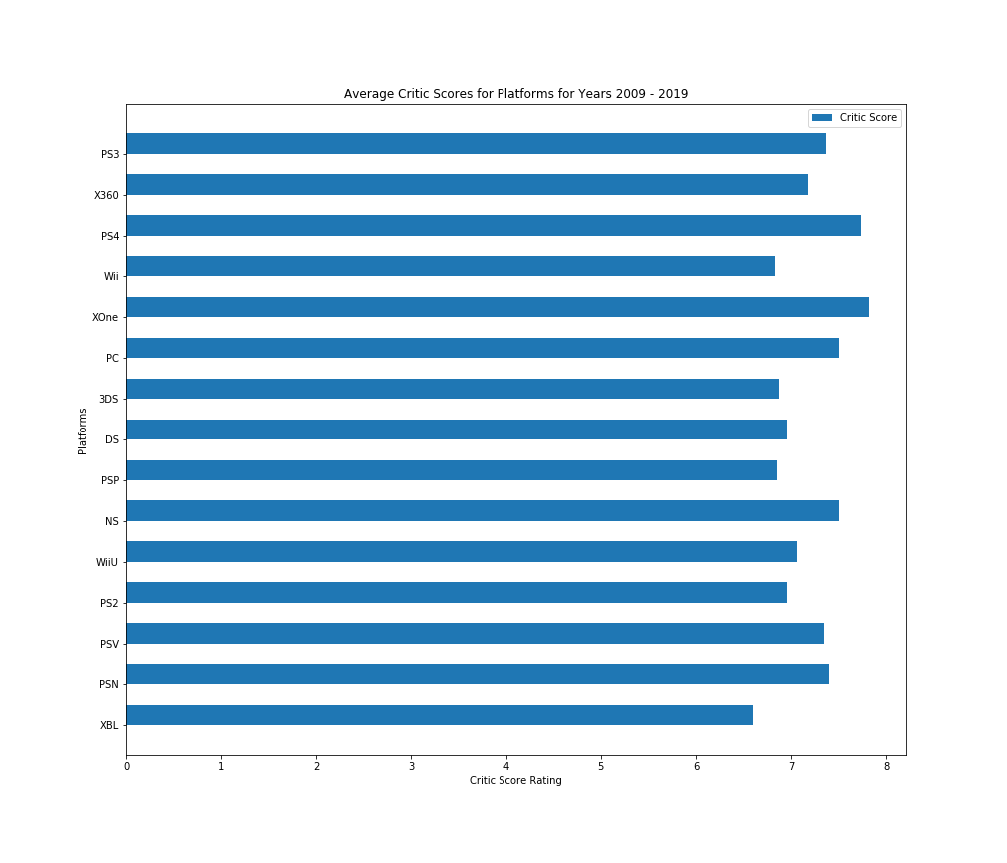
Global Sales vs. Critic Ratings for Different Platforms
Global Platform Sales*
Average Critic Scores
Top Sellers
Overall Critic Score
Playstation 3
Xbox 360
The average critic score was 7.2

Slide 21
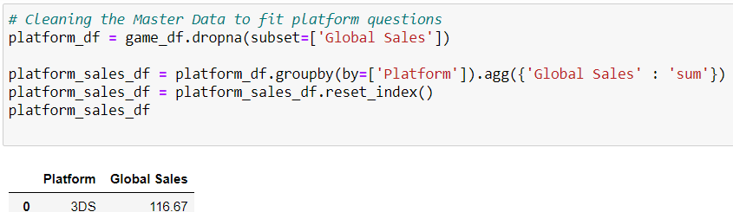
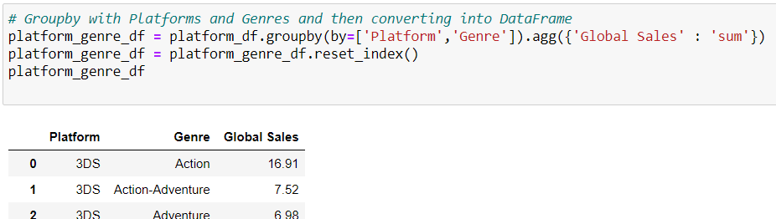
Global Sales for Video Game Genres for Different Platforms
Running groupby For Two Dataframes
Run groupbys for two separate criteria, one broken down by genre and platform, and the other by just platform and global sales.
Notes:
Dropna for a base df that I could pull from. First groupby was just based on global sales and the respective platform. So I can eventually run a sort values and select top performing platforms.
The secome groupby I wanted to aggregate based on the platform, genre and the global sales it had. This is the main dataframe that I would be analyzing.

Slide 22
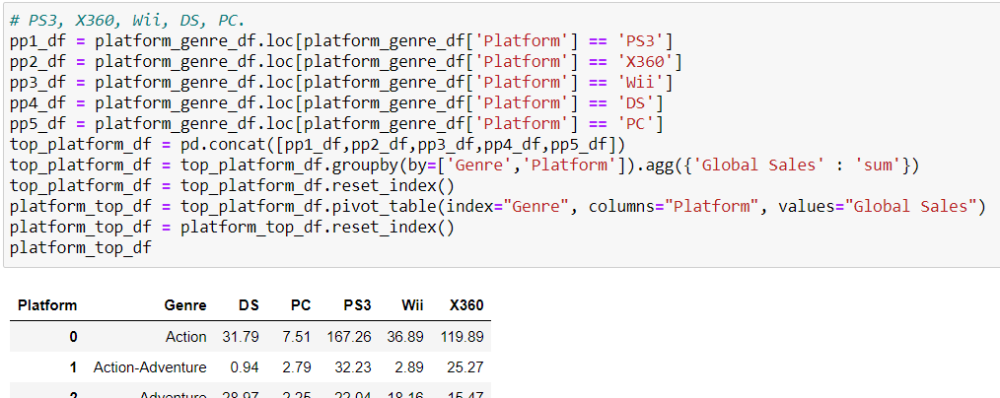
Global Sales for Video Game Genres for Different Platforms
Build the Dataframe based on Selection
Combined selected data-frames based on selection and then built the data-frame that we would base the grouped bar-chart on.

Slide 23
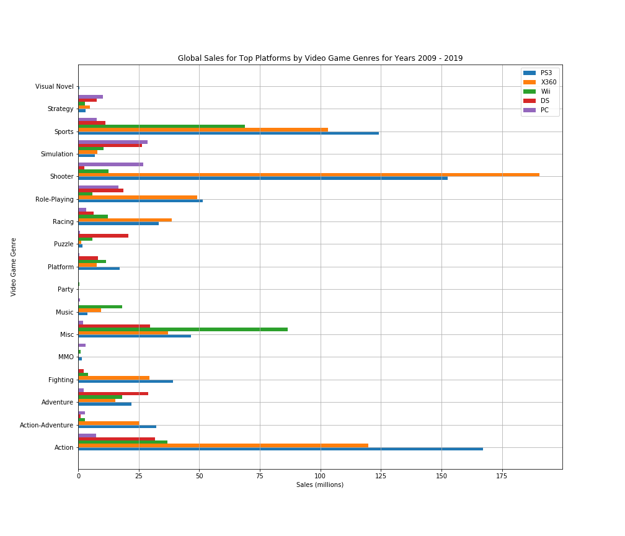
Global Sales for Video Game Genres for Different Platforms
PS3
Sports
Action
X360
Shooter
Wii
Misc.

Slide 24
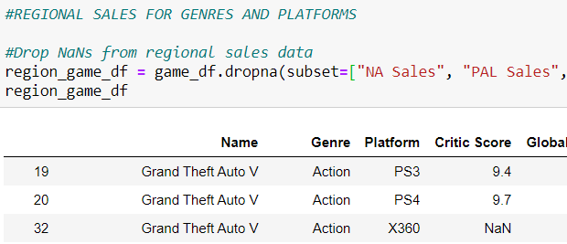
Regional Sales for Genres and Platforms
Drop Empty Cells
Used the dropna function to drop all rows with empty cells for regional sales and critic ratings

Slide 25
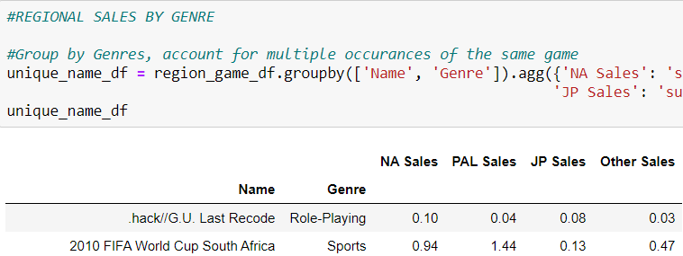
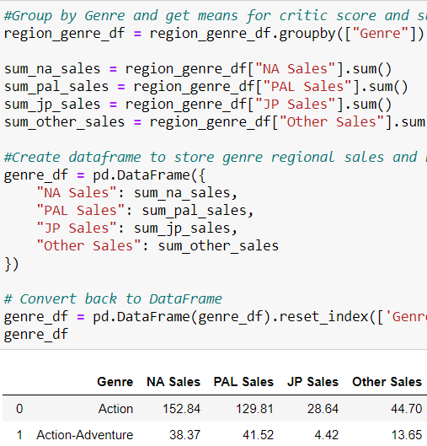
Genre Regional Sales: Data Cleaning
Remove Duplicates
Removed multiple occurances of the same games that were released on different platforms
Group By Genre
Used the grouby function for Genre
Calculate Sales
Calculate sums for sales in each region

Slide 26
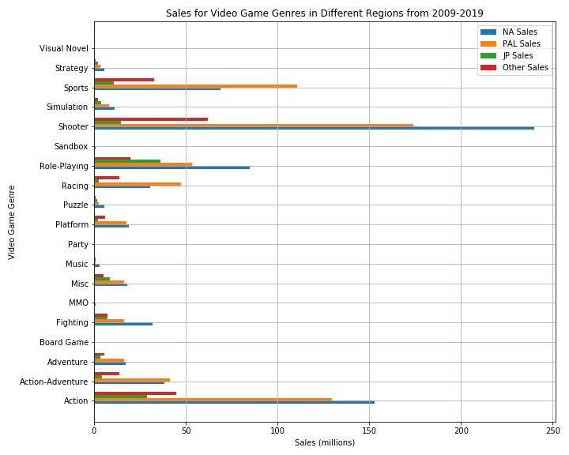
Genre Regional Sales: Analysis
NA
Shooter,
Action,
Role-Playing
PAL
Shooter,
Action,
Sports
JP
Role-Playing,
Action,
Shooter

Slide 27
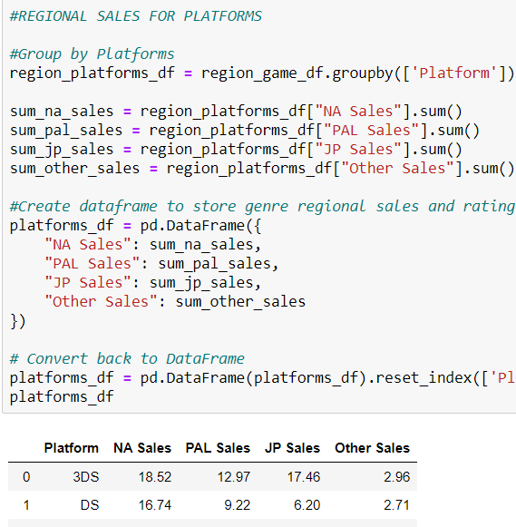
Platform Regional Sales: Data Cleaning
Group By Platform
Used the grouby function for Platform
Calculate Sales
Calculate sums for sales in each region

Slide 28
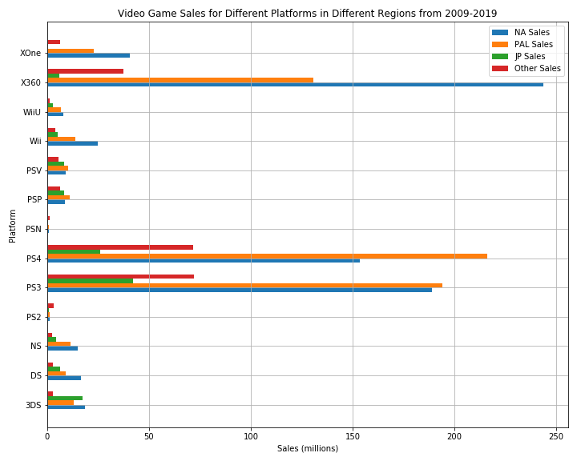
Platform Regional Sales: Analysis
NA
Xbox360
PlayStation
PAL
PlayStation
Xbox360
JP
PlayStation
3DS

Slide 29
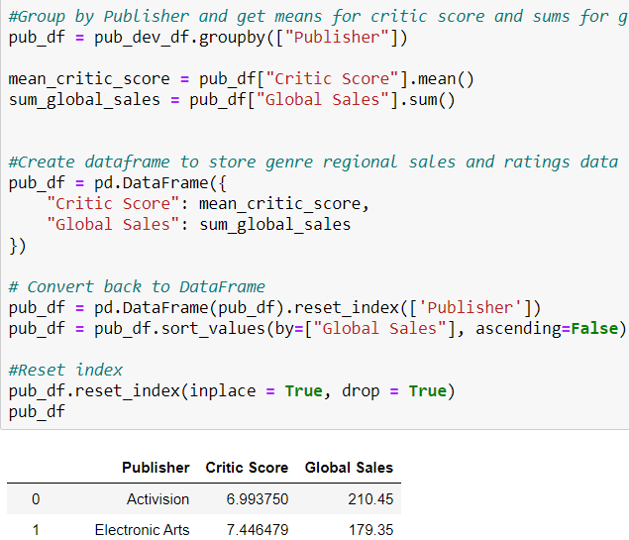
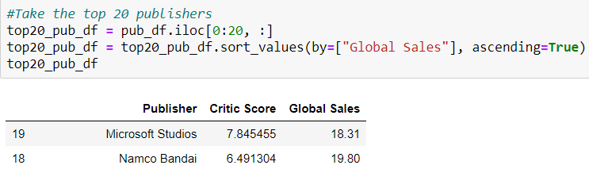
Publisher Sales vs. Ratings: Data Cleaning
Group by Publisher
Used the groupby function for Publisher
Calculate Sales & Ratings
Calculated the sum for global sales and mean for critic ratings
Extracted Top 20 Publishers
There were too many publishers to graph so we extracted the top 20 according to global sales

Slide 30
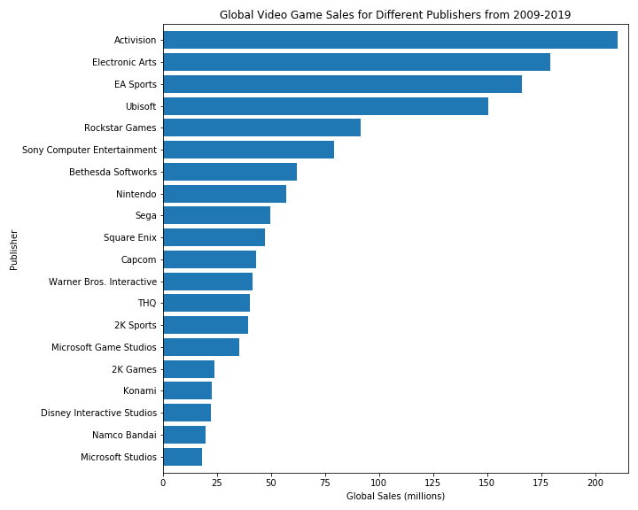
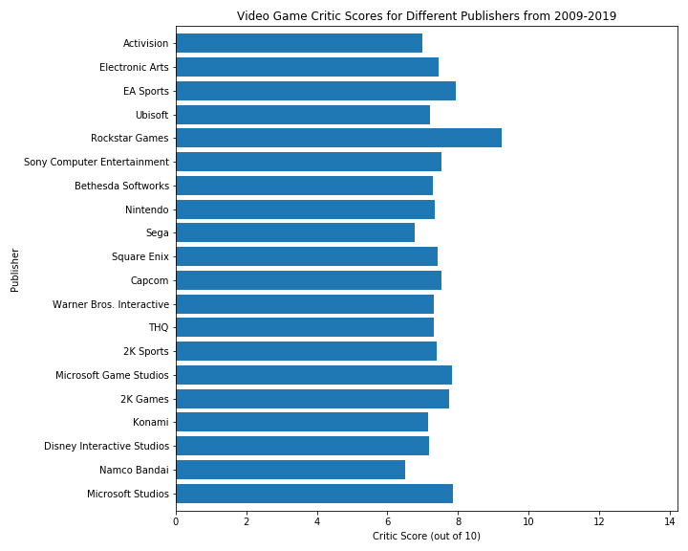
Publisher Sales vs. Ratings: Analysis
Sales
Ratings
No Relationship
Activision
EA
UBIsoft
Rockstar Games
EA
Microsoft

Slide 31
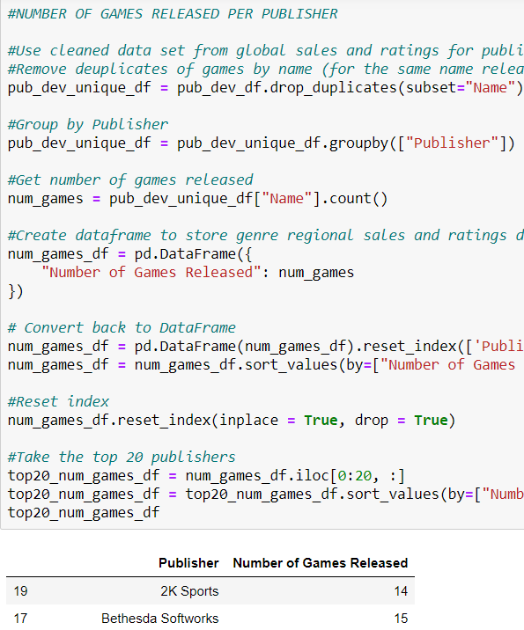
Number of Games Released per Publisher: Data Cleaning
Remove Duplicates
Removed multiple occurances of the same games that were released on different platforms
Group & Calculate
Used grouby function for Publisher. Calculated count of games released.
Extracted Top 20 Publishers
There were too many publishers to graph so we extracted the top 20 according to global sales

Slide 32
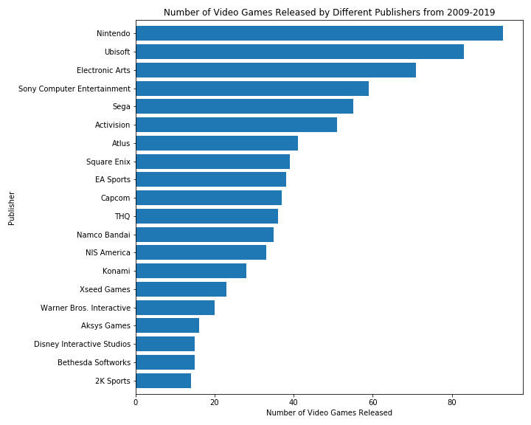
Number of Games Released per Publisher: Analysis
Sales
Game Count
Quality > Quantity
Activision
EA
Ubisoft
Nintendo
Ubisoft
EA

Slide 33

A Video Game is More Likely to Be Successful If…
Genre
Platform
Shooter
Action
PlayStation
Xbox
Publisher
Activision
EA
Ubisoft

Slide 34

DATA LIMITATIONS
Critic Ratings
Missing Data
Single Dataset
Current Trends
Source unclear
Dropping NaNs
Lack of diversity
Mobile games missing

Slide 35
THANKS!
Any questions?

Slide 36
THANKS
Does anyone have any questions?

Slide 37
CREDITS
RESOURCES:
Presentation template by Slidesgo
Icons by Flaticon
Infographics by Freepik
CSV downloaded from Kaggle web scrapped from VGChartz.

